Slide 1
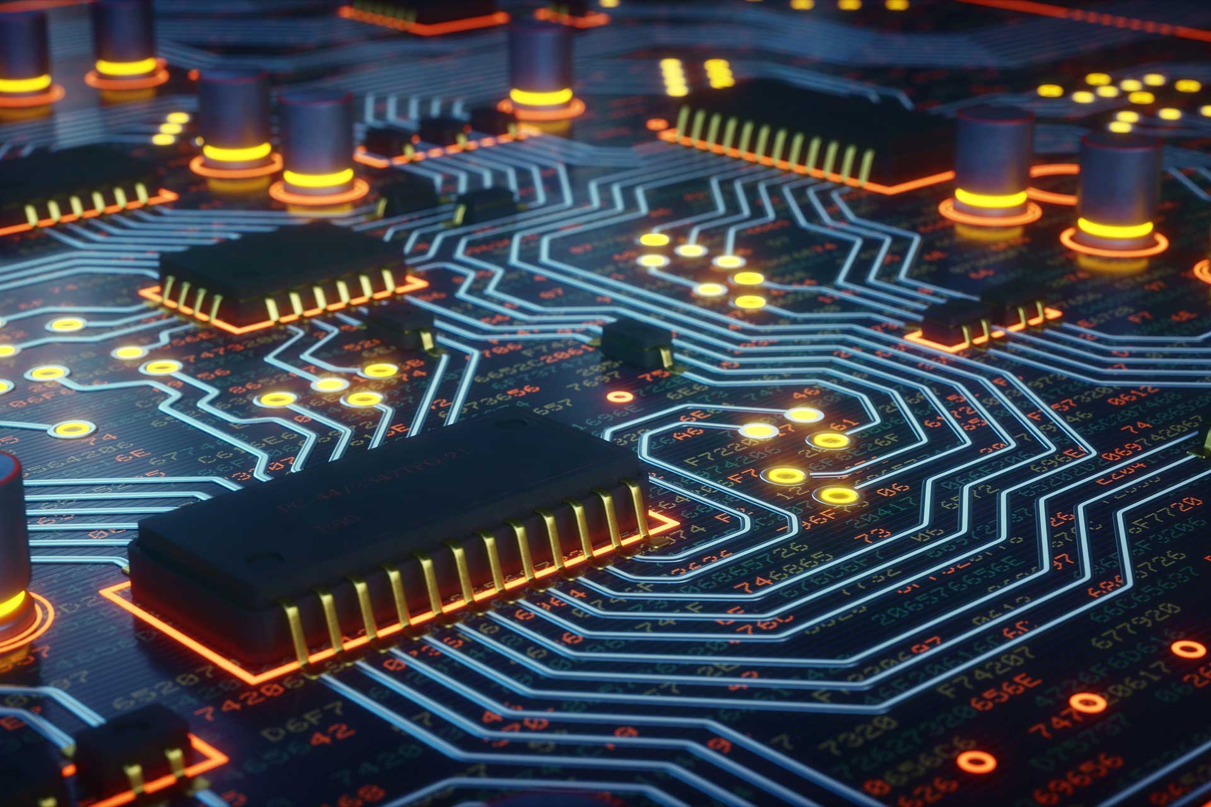
How to Make Almost Everything
Digital Electronic Design (1/2)
Brice PARILUSYAN
PhD Student
brice.parilusyan@gmail.com

Slide 2
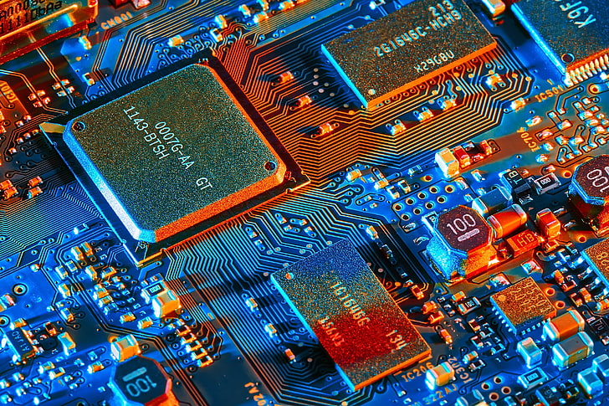
Course overview
01|
Fundamentals
02|
Semi-Conductors

Slide 3
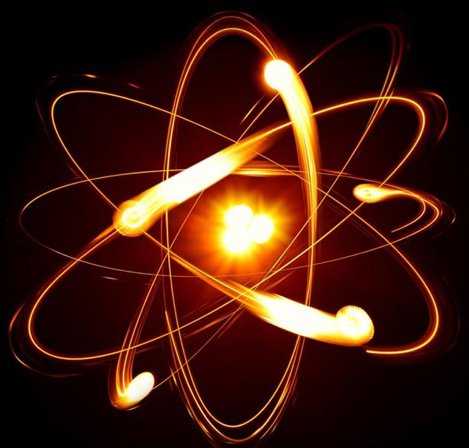
Fundamentals
Electricity Principles
Physical Implications
Passive Components
Resistors
Capacitors
Inductors
Basic Components

Slide 4
1|
Fundamentals
Electricity Principles
Atoms & Molecules
Electricity & liquid
Electric current
Electric tension
Ground
Potential difference
Active circuit

Slide 5
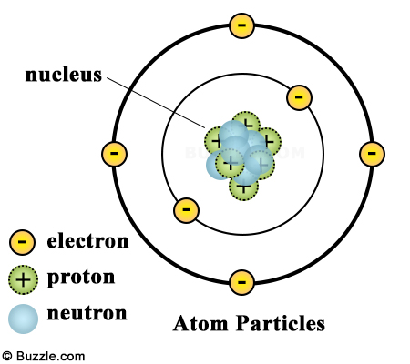
Atoms & molecules
1|
Fundamentals
Definitions :
An atom is composed of positive and negative loads. Both positive and negatives loads are in equal numbers.
An electronic layer is a position where negatives charges are positioned around the atom. Each one has a name and contains a maximum number of electrons :
K > 2
L > 8
M, N, O …
A molecule is a pack of atoms.
Notes:
Explication atomes avec couches électronic K, L, M …
Saut des électrons entre atom = courant
Liaison de valence maintine l’atom stable
Mettre sur 2 slides avec liaisons covalence
Mettre les ions

Slide 6
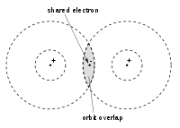
Atoms & molecules
1|
Fundamentals
Definition :
A valence layer is the last layer with an electron on it.
A covalence link is when an electron from a valence layer is shared with another atom.
The electricity is the ability of the electron to move from an atom to another. The balance in electric load is possible because of the covalence link.
Notes:
Explication atomes avec couches électronic K, L, M …
Saut des électrons entre atom = courant
Liaison de valence maintine l’atom stable
Mettre sur 2 slides avec liaisons covalence
Mettre les ions

Slide 7
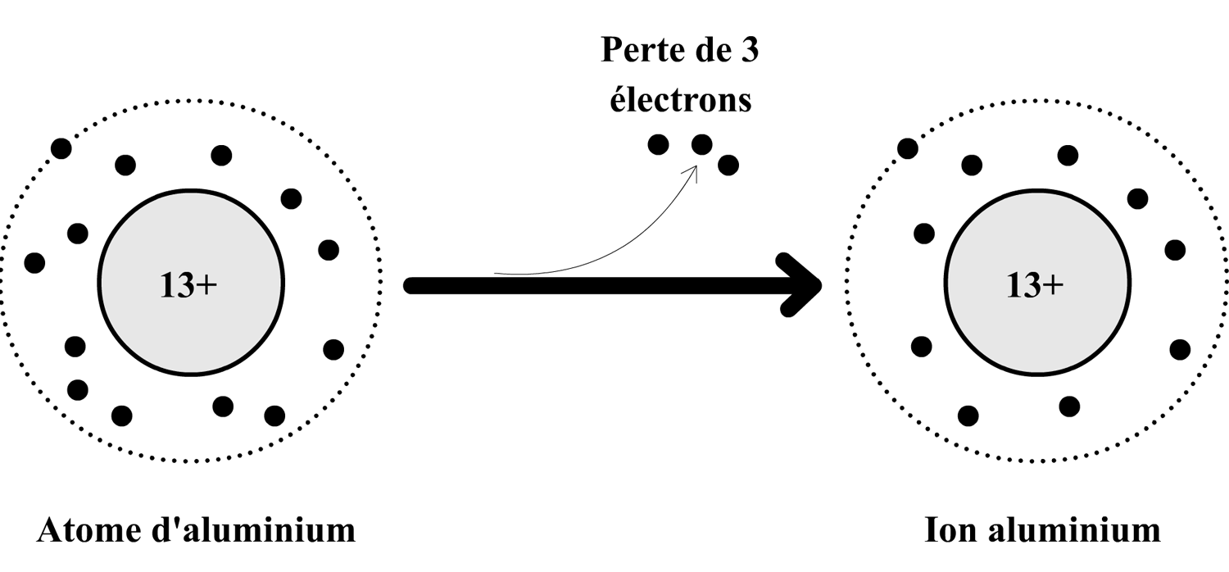
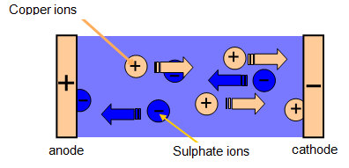
Electricity & liquid
1|
Fundamentals
Definition :
An Ion is an atom who lost his electric balance and is polarised. It occurs when the atom gains or loses electrons and can not compensate with the molecule.
With this effect, electricity in a liquid came by the creation and destruction of ion. Negatively charged ion will give their excess to the anode, and those electrons travel in the circuit until they reach the cathode to merge with positively charged ion.
Notes:
Explication atomes avec couches électronic K, L, M …
Saut des électrons entre atom = courant
Liaison de valence maintine l’atom stable
Mettre sur 2 slides avec liaisons covalence
Mettre les ions

Slide 8
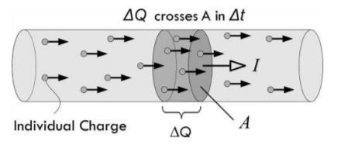
Electric current
1|
Fundamentals
Definition :
The intensity represents the number of electrons passing by a cross-section of a conductive element by seconds.
Properties :
Electron = -e = 1.602 x 10^-19 C
C = Coulomb
1 A = 1 C/s
1 A = 1C / 1s = 6.24 x 10^18 electrons/s
Intensity I is measured in Ampere A
Notes:
Exos sur calcul de charge
deltaQ = I x Delta T =2A 3s = 6C

Slide 9
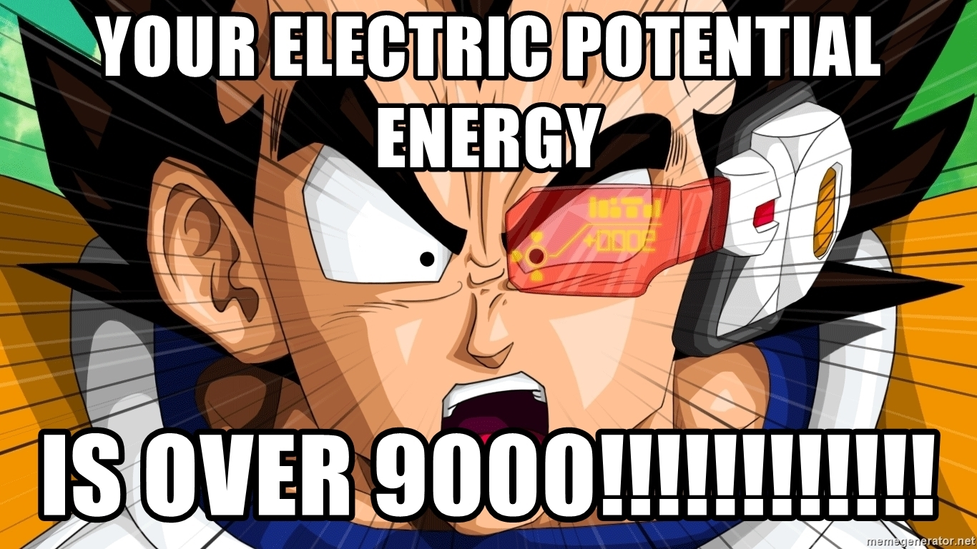
1|
Fundamentals
Electric potential
Definition :
An electric potential defines the electric state of a point in space. Each element has an electric load. This value is measured in volt.
1 volt = 1 Joule / 1 C
1 joule (J) is an energy unit

Slide 10


1|
Fundamentals
Potential difference
Definition :
A potential difference represents the power generated by the difference in electric potential between 2 points in space. It is also called voltage.
Analogy > Brat, Water
Properties :
Voltage = U or V
Electricity flow from positive to negative
Electron flow from negative to positive
Notes:
Notion joule / énergie à noté

Slide 11
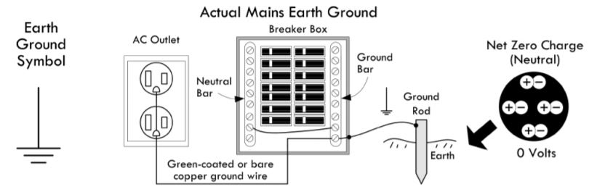
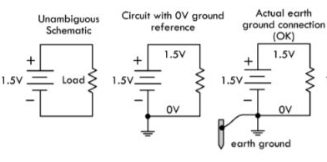
1|
Fundamentals
Ground
Definition :
The ground is the electric reference in an electric circuit.
The name ground comes from the fact that real ground (in building as an example) is a metallic stick stuck in the earth. It uses the electric potential from the earth

Slide 12
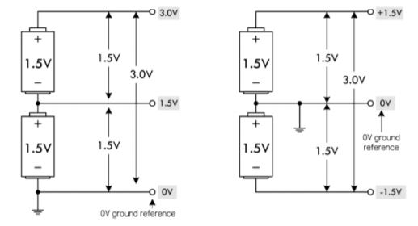
1|
Fundamentals
Ground
Properties :
The ground is the reference from which all tension are calculated
Electric tension can be added or subtracted, all is calculated from the ground and considering the electric generator polarization.

Slide 13
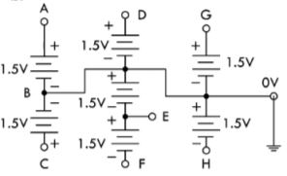
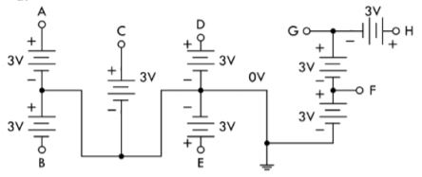
1|
Fundamentals
Ground
Exo1: find U in all points
Exo2: find U in all points

Slide 14
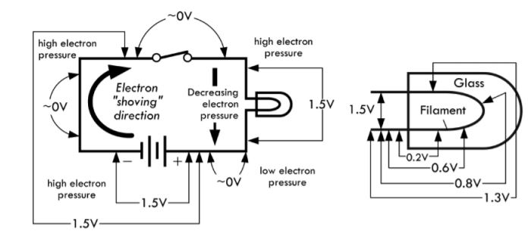
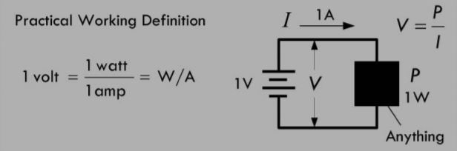
1|
Fundamentals
Active components
Definition :
An active component is an element that transforms current in other elements (heat, light, movement). These components cause a voltage drop.
A voltage drop is a voltage loss between the two poles of a component.
The Watt (W) is a power unit used in electricity.
W = U x I
Notes:
Composants actif = consomme courant

Slide 15
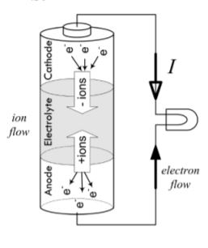
1|
Fundamentals
Battery
Definition :
A battery is a system able to store energy in a different form than electricity. Most of the time, energy is stored with chemical components and free it with a chemical reaction. Once the electrons accumulate to a side of the battery, it creates a potential difference between the two sides and generates an electric current.
Batteries have a limited life time. Some of them can be recharged.
Recycle batteries, it is important.

Slide 16
1|
Fundamentals
Physical Implications
Signals
Electric fields
Electromagnetism

Slide 17
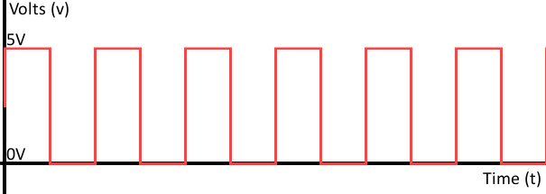
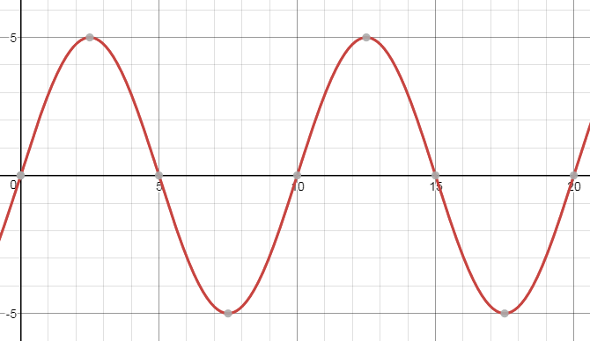
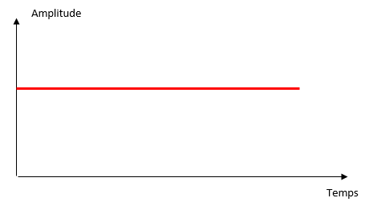
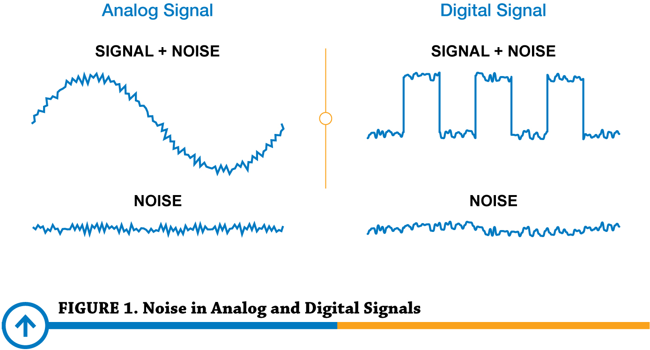
1|
Fundamentals
Signals
Definition:
A signal is an energy variation over time.
We use 3 kinds of signals :
Continuous signal
Analogic signal
Digital signal
All signals are made of :
A continue signal
An analogic signal
A parasitic noise

Slide 18
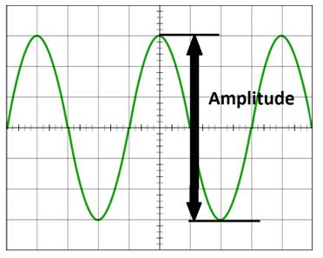
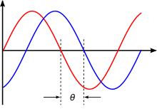
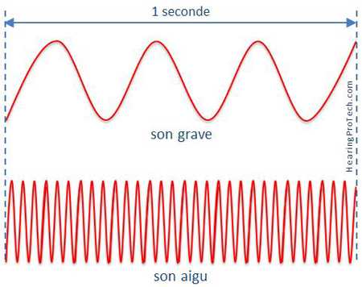
1|
Fundamentals
Signals
Definition :
A period is a pattern repeated in the signal
A signal is characterized by 3 different values :
Amplitude : maximal tension value
Phase : delay in period
Frequency : nb of periods in a second

Slide 19
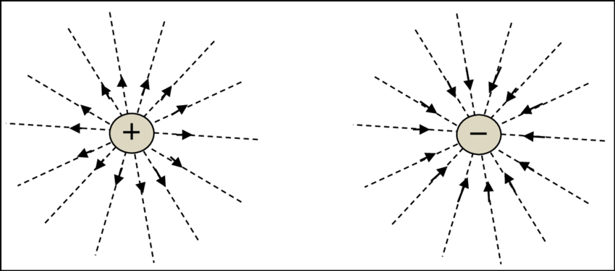
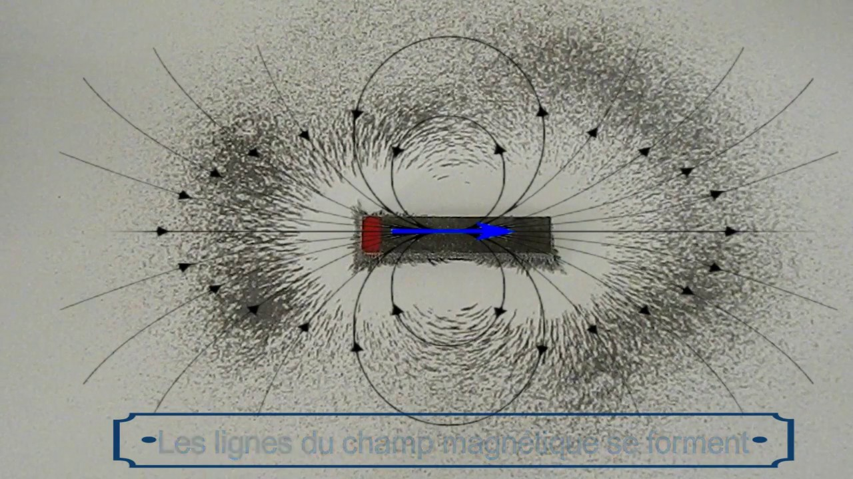
1|
Fundamentals
Electric fields
Definition :
An electric field is a vector field made from electrically charged opposite particles.
Properties :
The electric influence of a particle depends on the distance from it
Positive charge influence the field in the opposite of negative charge, it results in a magnetic attraction

Slide 20
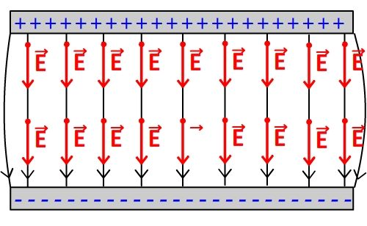
1|
Fundamentals
Electric fields
Properties :
If two plates facing each other are electrically charged in the opposite, this will create an electric field.
If a charged particle penetrates an electric field, it will be influenced by it, depending on his electric load.

Slide 21
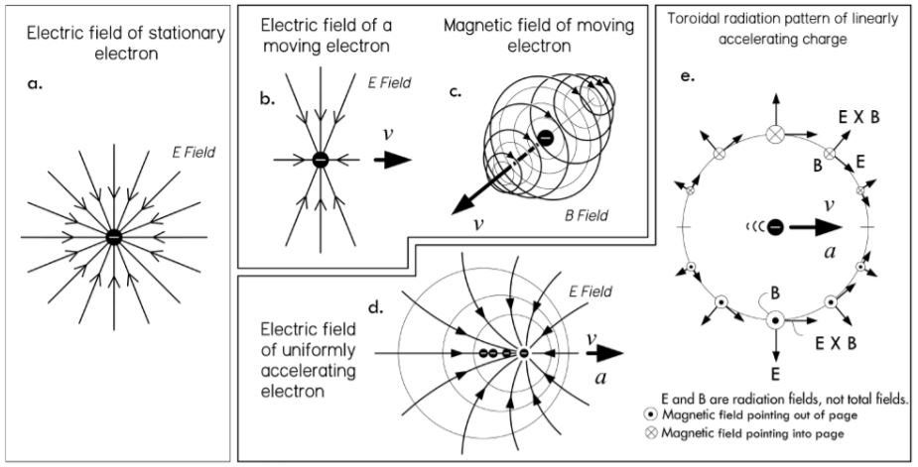
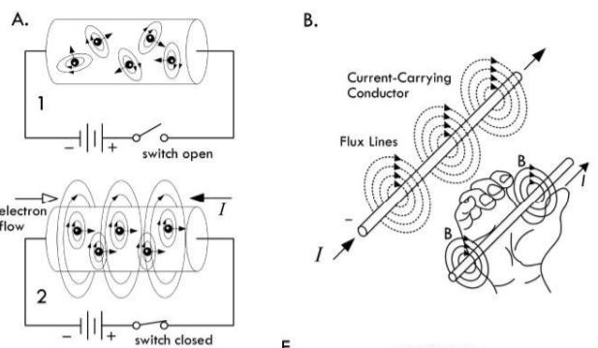
1|
Fundamentals
Electromagnetism
Definition :
Electromagnetism defines a domain when we study the effect of electric fields with magnetic fields.
A magnetic field is generated by the movement of an electrically charged particle. A magnetic field tends to initiate movements to other electric particles.
The right-hand rule is a method to find the direction of rotation of the magnetic field. The thumb shows the direction of the movement and the other fingers the magnetic field wrapping it.

Slide 22
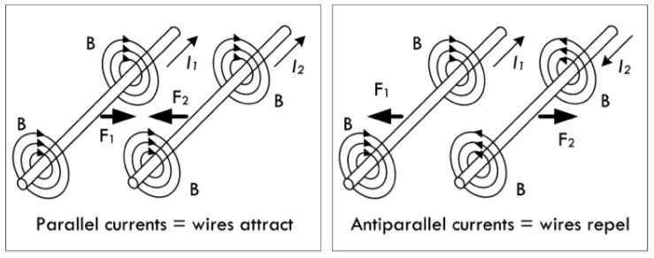
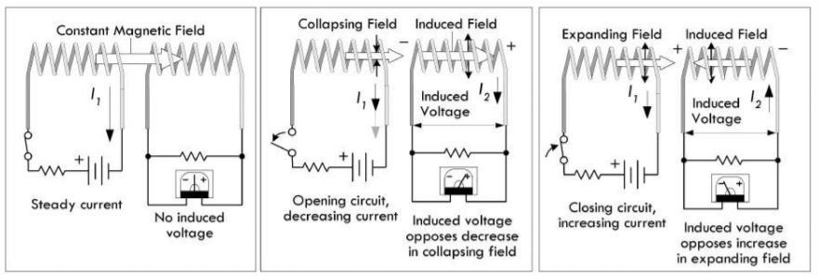
1|
Fundamentals
Electromagnetism
Definition :
Induce current represents the ability of a magnetic field to create a movement in the particles of wires inside his range. It means a magnetic field can generate current to a wire without physical contact.
Properties :
Two magnetic fields can interact. If the currents that generated them are in the same direction, the fields attract. If they are opposite, they repel.

Slide 23
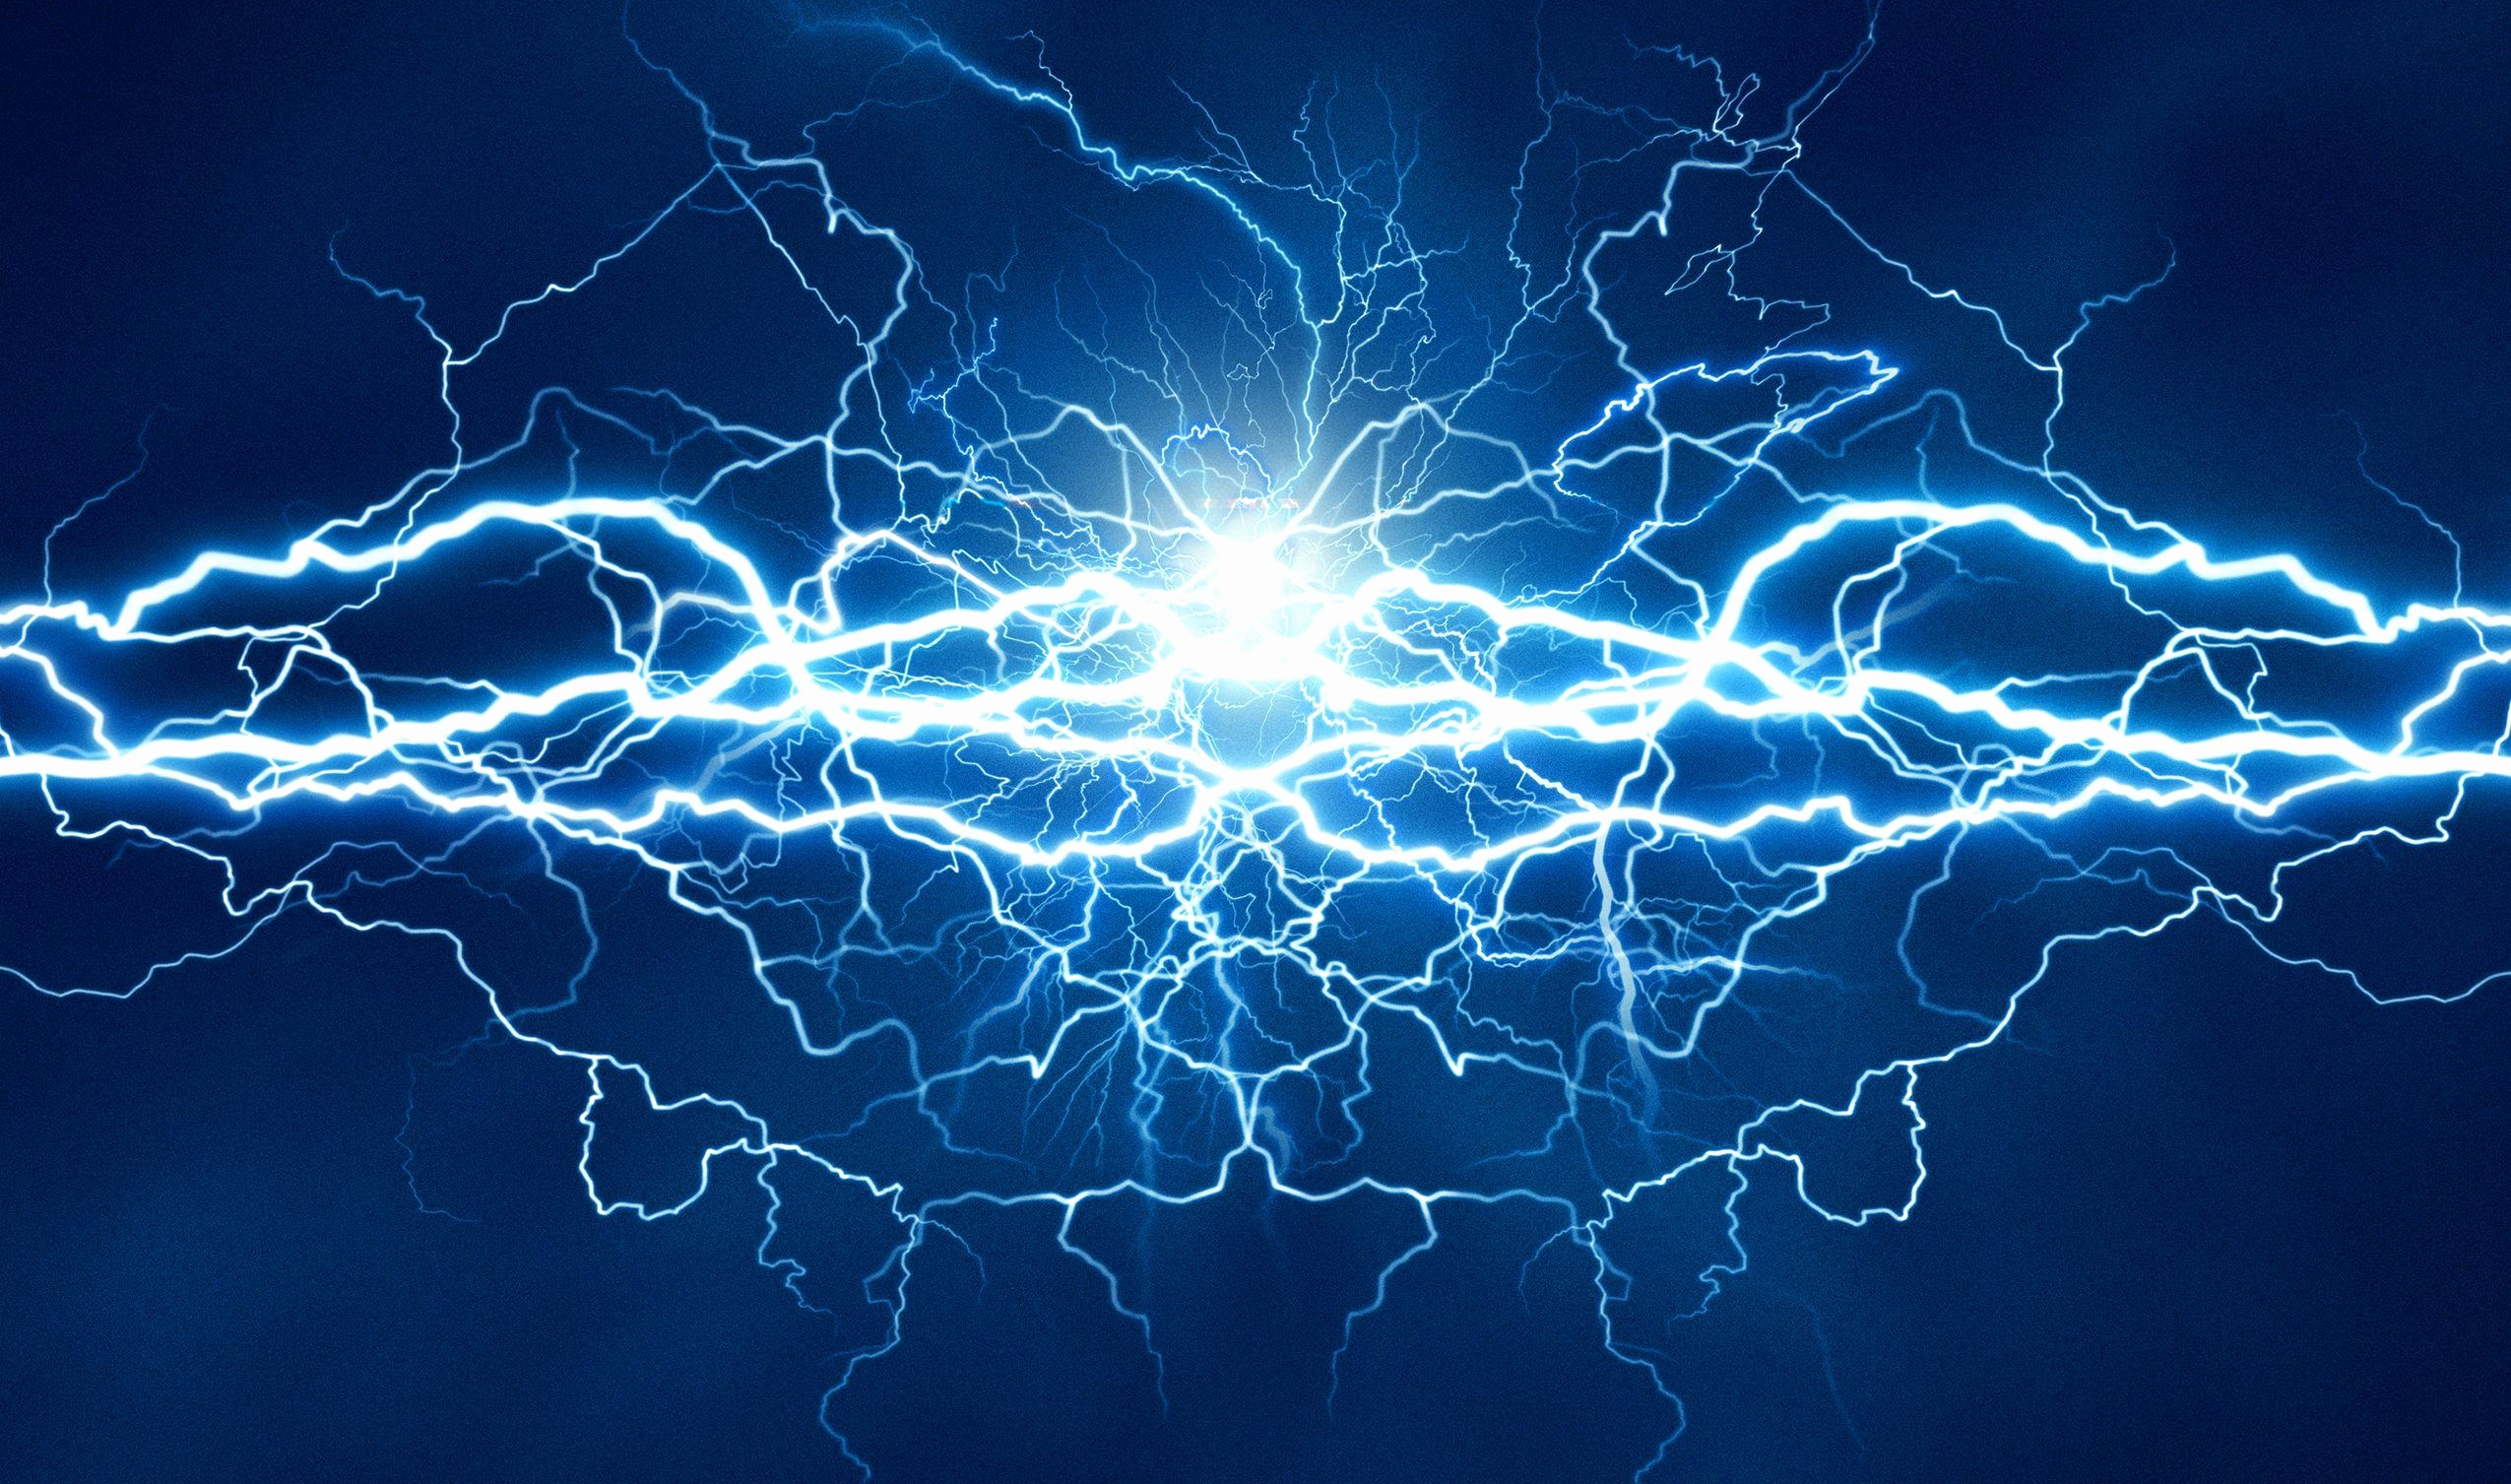
1|
Fundamentals
Resistors
Physic explication
Ohm’s law
Kirchhoff’s law
Thermal dissipation
Basic circuits
Parallel circuits
Series circuits

Slide 24
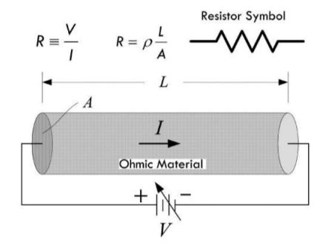
1|
Fundamentals
Resistors
Definition:
A resistor is a component that limits the amount of current passing through it. This limitation is made from a diameter reduction or change in material composition
A resistor is noted R. His value is in Ohm

Slide 25
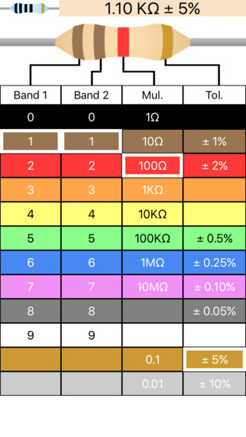
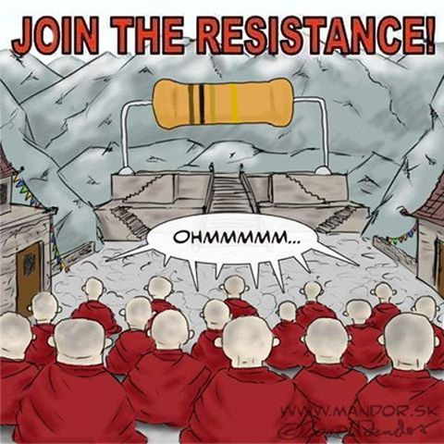
1|
Fundamentals

Slide 26
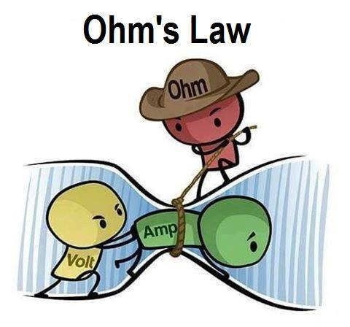
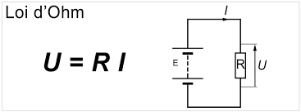
1|
Fundamentals
Ohm’s law
Definition :
The Ohm law is a linear relation between the value of a resistor, the current, and the voltage.
U = R x I
U represents the entering voltage. It is not affected by the resistor value.

Slide 27
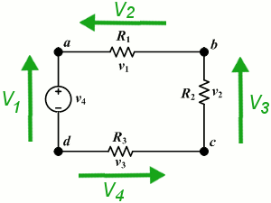
1|
Fundamentals
Kirchhoff’s law
Definition :
Kirchhoff’s law, or node law, represents the balance will of electricity. It says that in a close loop, all current value added is equal to 0.
V1 = V2 + V3 + V4
V4 + V2 + V3 – V1 = 0
Example :
V1 = 7v
V2 = 4v
V4 = 1.5v
V3 = ?

Slide 28
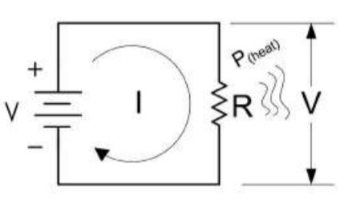
1|
Fundamentals
Thermal dissipation
Definition :
The thermal dissipation represents the heat produce by a component. This heat comes from the activity of the component, using electricity. Resistors produce a lot of heat. The formula to calculate it is a derivate of Ohm’s law.
Ohm’s Law :
U = R x I
Power Loss :
P = U x I
P = I² x R
P = U² / R

Slide 29
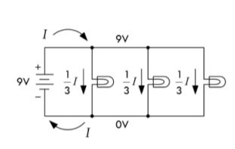
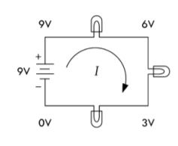
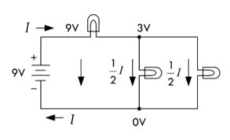
1|
Fundamentals
Parallel circuit
Basic circuit
Series circuit
Hybrid circuit

Slide 30
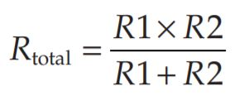
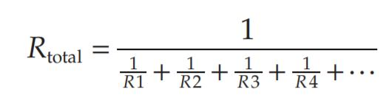
1|
Fundamentals
Parallel circuit
Properties :
A Parallel resistor circuit can be simplified in one resistor. The value of this equivalent resistor is calculated with the top formula. The bottom formula is a simplification of the top one with only two resistors

Slide 31
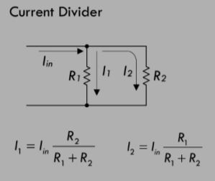
1|
Fundamentals
Parallel circuit
Properties :
A current divider is made from resistors in parallel. In this circuit the current is divided into the paths, the current value is depending on the resistors values.
Even without the U know, you can calculate the I in a current divider.

Slide 32
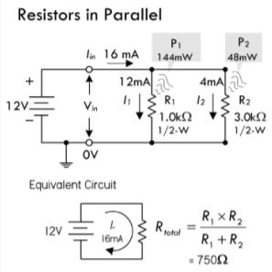
1|
Fundamentals
Parallel circuit
Example :
If a 1000- Ω resistor is connected in parallel with a 3000- Ω resistor, what is the total or equivalent resistance? Also calculate total current and individual currents, as well as the total and individual dissipated powers
Notes:
If a 1000- Ω resistor is connected in parallel with a 3000- Ω resistor, what is the total or equivalent resistance? Also calculate total current and individual currents, as well as the total and individual dissipated powers.
12V

Slide 33
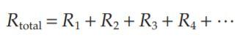
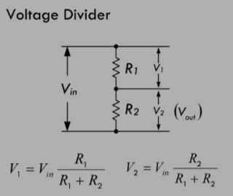
1|
Fundamentals
Series circuit
Definitions :
Resistors in series can be simplified by adding their values
A voltage divider is made from resistors in series. Depending on the resistance values, the current is divided between them.
V = Vin x (Ri / Rtotal)
Notes:
Example 1: If a 1.0- kΩ resistor is placed in series with a 2.0- kΩ resistor, the total resistance becomes: Rtot = R1 + R2 = 1000 Ω + 2000 Ω = 3000 Ω = 3 kΩ

Slide 34
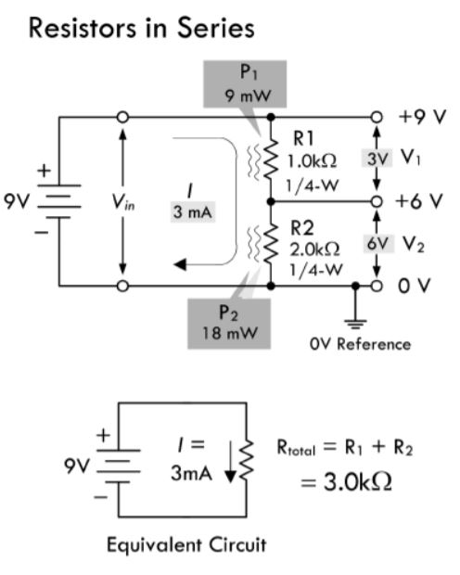
1|
Fundamentals
Series circuit
Example :
Example 1: If a 1.0- kΩ resistor is placed in series with a 2.0- kΩ resistor, the total resistance becomes:
Rtot = R1 + R2 = 1000 Ω + 2000 Ω = 3000 Ω = 3 kΩ

Slide 35
1|
Fundamentals
Capacitors
Physic explication
Capacitor types
Parallel circuit
Series circuit
Bypass capacitor
RC circuit

Slide 36
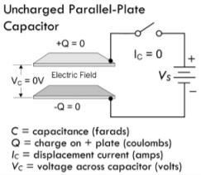



1|
Fundamentals
Physic explication
Definition :
A capacitor is composed of different layers of conductive plate facing each other. It generates an electric field between the plate when tension is applied.
Leakage current is phenomena that happen when a capacitor is disconnected from the power source, it means the capacitor loses his energy over time.
Capacitor values are in Farad (F)
1F = 1C/1V

Slide 37

1|
Fundamentals
Capacitor types
Properties :
Different kinds of capacitors exist. Fixed capacitors are usually made from ceramic.
Polarized capacitors have a plug way. They must be plugged in the right way, otherwise, there is a risk of explosion.

Slide 38

1|
Fundamentals
Parallel circuit
Definition :
Capacitors in parallel see their values adding, like for resistors in series.
Parallel capacitors limit the max voltage rating to that of the smallest capacitor.

Slide 39

1|
Fundamentals
Series circuit
Definition :
Capacitors in series increase the max voltage but decrease the capacitance value.
The capacitance value is lower than the smallest capacitor of the series

Slide 40


1|
Fundamentals
Series/parallel circuit
Example :
Find the total capacitance and maximum working voltage (WV) for the capacitor in the parallel network.
(b) Find the total capacitance, WV, V1, and V2.

Slide 41

1|
Fundamentals
Bypass capacitor
Definition :
A bypass capacitor is a capacitor connected between the ground and the VCC. This circuit helps to reduce potential noise coming from the alimentation or the circuit itself.

Slide 42

1|
Fundamentals
RC circuit
Definition :
RC circuits are used as oscillators. The charge/discharge time can be controlled with the values of the resistor and capacitor. This circuit consists of a resistor and capacitor in series. During the charge and discharge of the capacitor, the voltage value between the two components evolve
During charge, the voltage rise between the component.
Notes:
An IC uses an external RC charging network to control its timing. The IC requires 3.4 V at VIN to trigger its output to switch from high to low, at which time an internal transistor (switch) is activated, allowing the capacitor to be discharged to ground. If a 5- s timing period before the trigger point is required, what value of R is required if C = 10 µF?

Slide 43



1|
Fundamentals

Slide 44

1|
Fundamentals
RC circuit
Definition :
RC circuits are used as oscillators. The charge/discharge time can be controlled with the values of the resistor and capacitor. This circuit consists of a resistor and capacitor in series. During the charge and discharge of the capacitor, the voltage value between the two components evolve
During discharge, the voltage drop between the components
We consider a capacitor discharged after a time = 5𝜏

Slide 45


1|
Fundamentals

Slide 46
1|
Fundamentals
Inductors
Physic explication
Inductor fabrication
Series / parallel circuit
Inductive divider
RL circuit

Slide 47


1|
Fundamentals
Physic explication
Definition :
An inductor is a conductive wire twisted on itself in a reel. With this shape, every twist creates a magnetic field, all this field adds, and it creates a bigger magnetic field at the scale of the inductor.
Different kinds of inductors exist, some are twisted around magnetic or iron core to increase the magnetic field power.

Slide 48

1|
Fundamentals
Physic explication
Properties :
When we apply current to an inductor, it will start to load an electromagnetic field (EMF). During loading, the field will slow electrons in the wire and create a signal phase shift.
When the EMF is loaded, it works as a wire.
When the current source is removed, the EMF collapse. The discharge of the EMF creates a temporary power source.
The basic unit of inductor is the henry (H)
1H = 1V / 1A/s

Slide 49

1|
Fundamentals
Inductor fabrication

Slide 50



1|
Fundamentals
Series/parallel circuit

Slide 51

1|
Fundamentals
Inductive divider
Definition :
Inductive dividers can be used with ac input signals. A dc input voltage would split according to the relative resistances of the two inductors by using the resistive voltage divider

Slide 52


1|
Fundamentals
RL circuit
Definition :
An RL circuit is a resistor in series with an inductor, the resistance controls the rate at which energy is pumped into the magnetic field of the inductor (or pumped back into the circuit when the field collapses).
An RL circuit control the time that a circuit takes to reach its maximum current value

Slide 53

1|
Fundamentals
RL circuit

Slide 54



1|
Fundamentals
RL circuit
Caution :
In A, a break in current flow caused by opening a switch will cause a large inductive load’s magnetic field to collapse, thus generating a large forward voltage. Electron pressure between the switch contacts becomes so large that electrons escape the metal surface of one switch contact and jump toward the other contact. Through physics effects, it leads to a spark discharge across the switch contacts.

Slide 55

1|
Fundamentals
RL circuit

Slide 56

1|
Fundamentals
Basic Components
Transformers
Switch
Relay

Slide 57


1|
Fundamentals
Transformers
Definition :
A transformer is two inductors twisted around a magnetic core. One of the inductors will induce current inside the other.
The induced current depends on the number of twists of the inductors.
Both inductors are electrically isolated, they have air between them, it’s called galvanic isolation.
Ns = nb twist secondary
Np = nb twist primary
Vs = voltage secondary
Vp = voltage primary

Slide 58

1|
Fundamentals

Slide 59



1|
Fundamentals
Switch
Definition :
A switch is a mechanical device that interrupts or diverts electric current flow within a circuit.
Many different switches exist, all of them are simple mechanical contact between pins.
Switch, especially pushbuttons, are subject to the Gibbs effect. It is a noise created during the activation.

Slide 60

1|
Fundamentals
Switch
Definition :
Gibbs’s effect is a signal disruption happening during state switching. In electronics, a switch has a Gibbs effect at each switch. It came from the fact that electron “jumps” from one plate to another during the closing.
This effect is a problem for two reasons. First, it adds noise to your signal. Second, the voltage drop can be dangerous for your components.

Slide 61


1|
Fundamentals
Relay
Definition :
Relays are electrically actuated switches. The three basic kinds of relays include mechanical relays, reed relays, and solid-state relays. For mechanicals relay, a current sent through a coil magnet acts to pull a flexible spring who moves from one switch contact to another. Reed relays consist of a pair of reeds (thin, flexible metal strips) that spring together whenever a current is sent through an encapsulating wire coil. A solid-state relay is a device that can be made to switch states by applying external voltages across n-type and p-type semiconductive junctions
Before a relay, it is advised to put a component to avoid a current spike

Slide 62

Semi-Conductors
Physic Principles
Diodes
Transistors

Slide 63
2|
Semi-Conductors
Physic principles
Silicon structure
N-type silicon
P-type silicon

Slide 64


Silicon structure
2|
S-C
Definition :
Silicon is ranked second in the order of elements appearing in the earth’s crust, an average of 27 percent occurring in igneous rocks. Silicon is the most important semi-conductor used in building electrical devices.
Semi-conductors are atoms molecules with a specific range conductivity. They are naturally insulating but can be conductive with specific conditions.

Slide 65

Silicon structure
2|
S-C
Properties :
It is extremely rare to find silicon in its pure crystalline form in nature, and before it can be used in making electronic devices, it must be separated from its binding elements. After individuals (chemists, material scientists, etc.) perform the purification process, the silicon is melted and spun into a large “seed” crystal. This long crystal can then be cut up into slices or wafers that semiconductor- device designers use in making electrical contraptions.

Slide 66

N-type silicon
2|
S-C
Definition :
N-type silicon is created when we add a phosphorus (P) atom to the net. P has 5 electrons on his valence layer. 4 of them are stuck in covalent bonds, but the fifth is free.
The fifth electron will be able to move from the phosphorus atom and create the current.

Slide 67

2|
S-C
N-type silicon
Definition :
P-type silicon is created when we add a boron (B) atom to the net. P has 3 electrons on his valence layer. All of them will be stuck in a covalence bond. However, there will be a vacant spot, called a hole.
This hole can “move” between the silicon atom and create a current.

Slide 68

2|
S-C
Diodes
Physical structure
P-N junction
Schottky diodes
Zener diodes
Rectifier application
Circuit protection
Voltage management
Digital electronic
AM detector

Slide 69

2|
S-C
Physical structure
Definition :
A diode is a component that is composed of a P-type junction against an N-type junction.
Properties :
A diode allows the current to flow in only one direction
The silicon diodes create a voltage drop of 0.6 volts, it’s the necessary tension to initiate the conductivity.

Slide 70

2|
S-C
P-N junction
Definition :
The forward-biased position is activated when the current flow from P to N connection. At this moment, the free electrons of N try to pass through the P, and the holes of the P go against N and let electron flow through them.
The reverse-biased position is when the current flow from N to P. In this case, the electrons of N will be forced to the left, and holes of P will be forced to the right. It results in an empty zone around p-n junction That is free of charges. We called it the depletion region and it is insulant.

Slide 71

2|
S-C
Schottky diodes
Definition :
Schottky diodes have a particularly low junction capacitance and faster switching (∼10 ns) when compared to silicon p-n junction diodes due to their special metal-semiconductor junction interface. They also have a lower junction threshold voltage, around 0.3V. these characteristics enable them to detect low-voltage, high-frequency signals that ordinary p-n junction diodes would not see.

Slide 72

2|
S-C
Zener diodes
Definition :
A zener diode acts like a two- way gate to current flow. In the forward direction, it’s easy to push open; only about 0.6 V, just like a standard diode. In the reverse direction, it’s harder to push open; it requires a voltage equal to the zener’s breakdown voltage VZ. This breakdown voltage can be anywhere between 1.8 and 200 V, depending on the model

Slide 73

2|
S-C
Rectifier application
Definition :
A rectifier circuit is designed to modify a signal. With the right set of components, it is possible to change the shape of a signal to match your expectation.

Slide 74

2|
S-C
Rectifier application
Definition :
The wave rectifier is used to transform an AC signal in a full positive or full negative signal. It is the first step to create a DC from an AC signal.

Slide 75


2|
S-C
Rectifier application
Definition :
The full-bridge rectifier is a specific bridge rectifier designed to create the more powerful DC signal from an AC signal. It can reverse the negative parts of the signal into positive parts. With a diode and capacitor after, you can recreate a DC signal.
This circuit is used in all electric alimentations.

Slide 76


2|
S-C
Circuit protection
Properties :
As diodes allow current to flow in one direction, it helps to protect the circuit against the reverse current.
Used in parallel with a component that can generate a voltage, it avoid this component to burn the circuit with a reverse voltage.

Slide 77


2|
S-C
Circuit protection
Example :
When a working continuous motor is deprived of its power source, the remaining rotational movement creates a generate current and the motor becomes a generator. A parallel diode avoids this current to burn the circuit.
The activation / deactivation of a relay generates spikes in the circuit. A diode can avoid this spike and protect the circuit.

Slide 78



2|
S-C
Voltage management
Definition :
The voltage regulator uses the threshold voltage effect of the diode to reduce voltage.
RS = (Vin – Vout) / I
The voltage multiplier is a circuits that can obtain a DC voltage with a value superior to the maximum peak of the AC voltage it is created from.

Slide 79


2|
S-C
Digital electronic
Properties :
Logic gates can be created from diodes. The and gate use the reverse bias property. This kind of logic gates are less performant than with transistors but can be used for non-logic-level electronic (ex: battery backup with or gate)

Slide 80

2|
S-C
AM detector
Properties :
Diodes are often used in the detection of amplitude modulated (AM) signals. Here, a signal diode is then used to rectify out the negative portion of the incoming signal so it can be manipulated by the next dc stages. The rectified signal is then stripped of its high- frequency carrier by passing through a low- pass filter. The output signal is the audio signal.

Slide 81

2|
S-C
Transistors
Transistors
BJTs
JFETs
MOSFETs
Switch
Amplifier
Vibrator
Drivers

Slide 82



2|
S-C
Transistors
Definition :
Transistors are components made from 3 semi-conductive links. (NPN or PNP). They act as an electronic switch and can be activated by current, voltage, or both depending on the transistor.
The 2 main types are bipolar junction transistor (BJT) and field-effect transistors (FET). 2 differences: First, BJT needs current to be activated when FET needs only voltage.
Secondly, BJT draws some current from the circuit, which means it alters it. On contrary, FET draws nothing from the circuit, it doesn’t influence it.

Slide 83

2|
S-C
BJT
Definition :
Bipolar junction transistors (BJT) are three terminal devices that act as electrically controlled switches or as amplifier controls. These devices come in either npn or pnp configurations. A npn bipolar transistor uses a small input current and positive voltage at its base (relative to its emitter) to control a much larger collector to emitter current. Conversely, a pnp transistor uses a small output base current and negative base voltage (relative to its emitter) to control a larger emitter to collector current

Slide 84

2|
S-C
JFET
Definition :
Junction field-effect transistors (JFETs) are three-lead semiconductive devices. Unlike bipolar transistors, JFETs are exclusively voltage-controlled, they do not require a biasing current. Another unique trait of a JFET is that it is normally on when there is no voltage difference between its gate and source leads. However, if a voltage difference forms between these leads, the JFET becomes more resistive to current flow. For this reason, JFETs are referred to as depletion devices, unlike bipolar transistors, which are enhancement devices (bipolar transistors become less resistive when a current/voltage is applied to their base leads).

Slide 85

2|
S-C
MOSFET
Definition :
Metal oxide semiconductor field-effect transistors (MOSFETs) are incredibly popular transistors. They work in a similar way to JFET. Like them, they do not draw ant current from the circuit and are voltage driven. The two major kinds of MOSFETs are enhancement-type MOSFETs and depletion-type MOSFETs
Depletion-type MOSFETs work in a similar way to JFET, they are naturally conductive and became more resistive depending on the voltage applied to the gate.
Enhancement-type MOSFETs are normally off. However, if a voltage is applied to its gate lead, the drain-source channel becomes less resistive.

Slide 86

2|
S-C
Thyristors
Definition :
Thyristors are two to four-lead semiconductors devices who acts as a switch. Their specialty is that some of them are designed to switch on when the voltage across its leads reaches a specific level, known as the breakdown voltage. Thyristors are less tricky to use than other transistors concerning their switching states. They can be only on or off when transistors had a resistance variation.

Slide 87

2|
S-C
Switch
Definition :
The switch use of a transistor is one of the most common uses of this component. Even if the transistors doesn’t behave as a binary switch (not 2 states but a resistance variation), the transistor switch is the base of logic gates.

Slide 88

2|
S-C
Amplifier
Definition :
An amplifier circuit is used to create a significant electric flow from a little one. Amplification is used to increase the power of a signal.

Slide 89

2|
S-C
Vibrator
Definition :
A vibrator circuit can create a periodic and stable signal. It is often used to rhythm the operations in a circuit.

Slide 90

2|
S-C
Driver
Definition :
A driver is a circuit who can perform signal modification to activate/deactivate/drive an electronic element (motor, inductances). The most common driver is the H-bridge. It is used to invert the rotation of a continuous motor by inverting his voltage.

